Slide 1
Test Driven Development (TDD)
Programming Advanced

Slide 2
Objectives
Create ASP.NET Core MVC applications in a test driven way. So first you must
Learn Test Driven Development (TDD)
Be able to create test doubles with a mocking framework (Moq)

Slide 3
Recommended Pluralsight Courses
Introduction to testing with NUnit:
https://app.pluralsight.com/library/courses/nunit-3-dotnet-testing-introduction
TDD in action:
https://app.pluralsight.com/library/courses/play-by-play-wilson-tdd

Slide 4
Automated tests
Automated software testing is a process in which software tools execute pre-scripted tests on a software application before it is released into production.
Different kinds of tests:
Unit tests (Test a small unit of code, e.g. class method)
Integration tests (Test a process involving multiple objects)
End-To-End tests (Simulate input and check resulting output)

Slide 5
Why do automated testing?
Happier development team
Find defects earlier -> fewer bugs in production -> fewer late nights/weekend work
Fewer bugs in production -> more time to add new features
Happier users
Fewer defects reaching production causing annoyance
Reduced business cost
Defects found earlier in development lifecycle
Reliability
Exactly same test code runs each time
No variance between runs from Human error
Faster execution
Quicker than a human performing tests manually
Notes:
Why write automated tests?
Well, there's a number of benefits:
First off, it helps to create a happier development team.
One of the ways automated tests can help us in this regard is to find defects earlier in the development lifecycle process, so fewer bugs making it through to production means fewer late nights or weekend work trying to debug errors in production.
Also, because we're spending less time firefighting problems in production, we actually get more time to work on new features or perhaps pay off some technical debt in the application.
Automated tests can help to create happier users because we're finding defects sooner in the application development process. Fewer defects reach production, so this means fewer defects actually surfacing to end users.
Automated tests can also benefit the business by reducing costs. Because we're finding defects now earlier in the development lifecycle, they're cheaper to fix. So, for example, if we've just written a line of code and we run our tests and they fail, we know we've caused a problem right there and then, as opposed to a few weeks or months down the road when we get a bug report from a customer, but they don't remember exactly what happened. We now have to go into the production environment, look through log files, and try to discover where the actual problem is. This creates additional cost for the business because rather than adding new features to the product the development team is now firefighting problems in production.
Some of the features of good automated tests include a sense of reliability.
So we're running exactly the same test code each and every time we execute our tests. This means if nothing has changed in the code base we should get exactly the same results, pass or fail, that we did the last time.
Also, because our testing is automated now, there's no variance between test runs due to human error. So, for example, if a developer or tester is running the application and checking that code features work, there's some potential now for human error in the process, which could result in bug reports when they're not actually bugs or misdiagnosis of existing bugs.
Automated tests also give us faster execution of our test runs, so we can more quickly execute a suite of tests that are automated than we can if a human has to perform these tests manually.

Slide 6
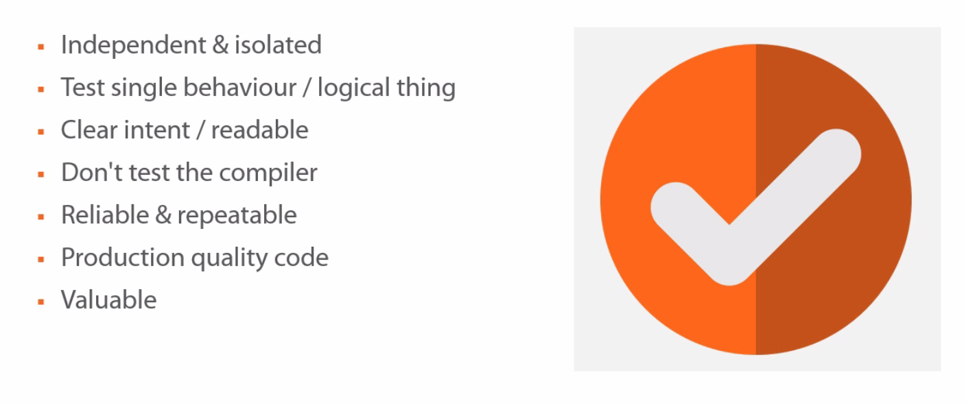
What Makes a Good Test ?
Notes:
What Makes a Good Test?
Let’s first consider some factors that contribute to making a good test.
First off, each individual test should be independent and isolated from all of the other tests. If we have two tests, A and B, if test A runs and then test B runs, we should get the same result as if the order was reversed. If test B runs first and then test A runs, we should still get the same results for each test. In this way, the tests should be independent of each other, they should be able to be run in isolation or with a whole host of other tests and still get the same results.
Each test should test a single behavior or a single logical aspect of the system that we're testing, it's okay to have multiple Assert statements in a single test, as long as they're related to testing a single logical behavior. For example, in a single test for our calculator, we wouldn't have both the multiplication and addition being asserted on.
Just as with production code, the intent of this test should be clear to the reader, so we shouldn't have large sprawling test methods that are hard to read and hard to understand what the actual thing is we're testing.
We don't want to test the compiler, for example, if we're using C#'s auto-implemented properties we don't need to test that the PropertySet and the PropertyGet is working correctly. The setting and getting for the values of our auto-implemented property are handled by the compiler, we don't need to test these. If, on the other hand, we're not using auto-implemented properties and we've got some code in our get or set, then this is something that we probably should test.
A good test is reliable and repeatable. It's reliable because we should always trust the output of the test. We shouldn't be second guessing it. Good tests should also be repeatable. That means they should produce the same result given the same set of circumstances, every single time. If the code base hasn't changed and a test sometimes passes and fails, then it's neither reliable nor repeatable.
As we alluded to, test code should be of equal quality as our production code, we should apply all of the same techniques that we use in production code to our test code.
Overall, tests should be valuable to the development team. We should always make sure that we get some benefit from the effort that we put into writing automated tests.

Slide 7
Testing Frameworks / Test Runners
Production Code
Test Code
Test Runner
Visual Studio Test Runner
Testing Framework
NUnit Test Adapter
NUnit
Notes:
Testing Frameworks and Test Runners
So before we look at NUnit itself, let's take a brief moment to consider the roles of testing frameworks and test runners.
So here we have our production code that we want to write tests for.
The first thing we're going to do is create a test project and write some test code that executes this production code.
Although it's possible to write this test code without using any kind of testing framework or test runner, for example, we could write a console application with a series of methods containing the tests.
A test framework, as its name implies, gives us a well thought out framework for organizing and executing our tests. So our test code can make use of a prebuilt existing testing framework, and NUnit is a popular example of one of these testing frameworks (MS Test is the build in testing framework that ships with Visual Studio).
So now we have our test code that's making use of this testing framework, we need some way to execute our tests. We can execute our test code by using test runners, and these come in a variety of shapes and sizes. The test runner that we're using understands the testing framework that our test code is using, so it knows how to identify individual tests that need running and also how to report on if these tests have passed or failed. After installing the Nunit Test Adapter extension in Visual Studio we can use the build in test runner of Visual Studio.

Slide 8
NUnit as Test Framework
Testing with the NUnit framework was covered in the .NET Advanced course.
We recommend to refresh your memory with the following Pluralsight course:
https://app.pluralsight.com/library/courses/nunit-3-dotnet-testing-introduction

Slide 9
Test Driven Development (TDD)
Use unit tests to drive the design
Test First
Red Green Refactor
Red: write a test that fails
Green: write (just enough) code to make the test pass
Refactor: clean up the code (remove duplication, improve design)
Repeat
Notes:
Test Driven Development (TDD)
Unit testing means testing, of course, a single unit, typically a class or even better, the function of a single method.
Unit tests are created in isolation of one another and in isolation of the rest of the program.
You're testing a very small unit of functionality.
Test driven development builds upon unit testing, but uses those tests to drive the design of your application.
To do test driven development, you're going to test first, that is rather than writing the code and then creating a test to see if it works.
You create the test first, that becomes the specification of the code, and you write enough code to make the test pass.
As we suggested, test driven development begins with unit tests and works from a test-first perspective. This is often referred to as red green refactor.
In the red phase you create a failing test,
In the green phase you write just enough code to pass that test
Then you refactor, cleaning up the code in a way that does not cause the test to fail. So all of the refactoring is internal and does not change the way you interact with the code.
You then repeat the red green refactor cycle indefinitely.

Slide 10
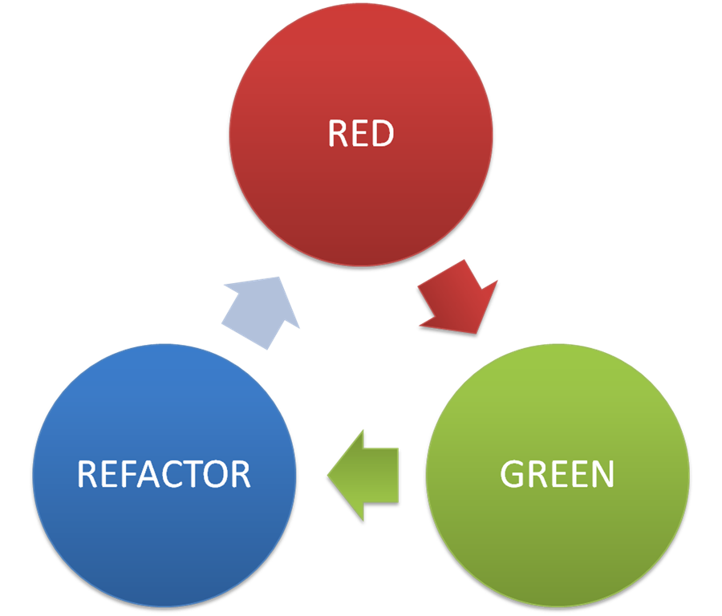
Test Driven Development (TDD)
Notes:
Write a test that fails
Write (just enough) code to make the test pass
Refactor your code (remove duplication, improve design)
Repeat…

Slide 11
Robert C. Martin’s 3 laws
No production code until you’ve written a failing test
Write no more in your unit test than enough to make it fail
Write no more production code than enough to make it pass
Notes:
Robert Martin, aka Uncle Bob, has promulgated three laws for successful TDD:
Write no production code until you've written a failing test.
This is probably the most confusing and challenging of the three for novices to TDD, and we will take a look at why you do this and how you do this.
Write no more in your unit test than enough to make it fail.
And an equally challenging command, write no more production code than enough to make it pass.
When you're writing your tests, it's important to keep in mind that you want to test only one feature.
You write the test first, run it, and see it fail, and this is very important because only by seeing it fail can you have confidence when you see it pass, that you have corrected the problem.
Fix only enough to make it pass.
Don't get ahead of yourself and say well, I'm going to need this anyway.
There are a couple reasons for that.
One comes under the acronym YAGNI, You Ain't Gonna Need It.
It's very tempting to add features and aspects to your program that you're quite certain you will need, and it turns out you won't.
But also if you get ahead of the test, if you write more than enough to pass the test, then you have effectively untested code, and in all likelihood that code will never be tested.
After you've written enough to make it pass, run the test and see it succeed, and then you're ready to refactor and retest to make sure that your refactoring has not broken the test. At that point, you return to the red cycle and write a test that you know will fail.

Slide 12
What is refactoring?
Refactoring = changing the structure of the code without changing its external behaviour
Refactoring
Improves code readability
Reduces complexity
Improve architecture / object model
=> Better maintainability, extensibility
Notes:
What is refactoring?
Code refactoring is the process of changing a computer program’s source code without modifying its external functional behavior, in order to improve some of the nonfunctional attributes of the software.
Advantages include
improved code readability and reduced complexity to improve the maintainability of the source code
more expressive internal architecture or object model to improve extensibility.
Refactoring is usually motivated by noting a code smell. For example the method at hand may be very long, or it may be a near duplicate of another nearby method. Once recognized, such problems can be addressed by refactoring the source code, or transforming it into a new form that behaves the same as before, but that no longer “smells”.
There are two general categories of benefits to the activity of refactoring:
Maintainability. It is easier to fix bugs because the source code is easy to read and the intent of its author is easy to grasp. This might be achieved by reducing large monolithic routines into a set of individually concise, well-named, single-purpose methods. It might be achieved by moving a method to a more appropriate class, or by removing misleading comments.
Extensibility. It is easier to extend the capabilities of the application if it uses recognizable design patterns, and it provides some flexibility where none may have existed before.

Slide 13
Refactoring
Use meaningful and descriptive names
DRY – Don’t Repeat Yourself
Also refactor your tests!
SOLID (out of scope for this course)
Notes:
DRY
Duplication (inadvertent or purposeful duplication) can lead to maintenance nightmares, poor factoring, and logical contradictions.
The DRY (Don't Repeat Yourself) principle states:
Every piece of knowledge must have a single, unambiguous, authoritative representation within a system.
A piece of knowledge = code, architecture, requirements, documentation, …
When the DRY principle is applied successfully, a modification of any single element of a system does not require a change in other logically unrelated elements.
SOLID (out of scope for this course)
Acronym for the “first five principles” named by Robert C. Martin.
The intention is that these principles, when applied together, will make it more likely that a programmer will create a system that is easy to maintain and extend over time.
The principles of SOLID are guidelines that can be applied while working on software to remove code smells by providing a framework through which the programmer may refactor the software's source code until it is both legible and extensible.
S – Single Responsibility principle (a class should have only a single responsibility)
O – Open/closed principle (software entities should be open for extension, but closed for modification)
L – Liskov substitution principle (objects in a program should be replaceable with instances of their subtypes without altering the correctness of that program)
I – Interface segregation principle (many client-specific interfaces are better than one general-purpose interface)
D – Dependency inversion principle (one should depend upon abstractions, not concretions)
Pluralsight: https://app.pluralsight.com/library/courses/csharp-solid-principles (out of scope for this course)

Slide 14
Extra benefits of TDD
We already described the benefits of automated tests. But TDD has some extra benefits:
Higher Acceptance
Avoid scope creep (unnecessary code)
Modularized, flexible, and extensible code
…
Notes:
Benefits of test driven development
Higher Acceptance: TDD implementation is more likely to match the product owners vision for the user story. The test cases are easily generated from the acceptance criteria without interference from the constraints of the architecture design or programming constructs. TDD guarantees to some degree that the final version will fulfill the needs of the stakeholders as communicated by the product owner.
Avoid Scope Creep:
TDD prevents unwarranted design or components to sneak into the product. The test cases or unit tests define the exact set of required features.
TDD makes it easy to identify redundant code, detect and terminate unnecessary engineering tasks.
Modulation:
TDD can lead to more modularized, flexible, and extensible code.
The technique requires your team to think of the software in terms of small units that can be written and tested independently and integrated together later.
And more:
Writing the tests first requires you to really consider what do you want from the code
Fast feedback. Identify the error/problem quickly
Reduces time spent on rework
The resulting Unit Tests are simple and act as documentation for the code. Since TDD use-cases are written as tests, other programmers can view the tests as usage examples of how the code is intended to work
Less time spent in the debugger
Tells you whether your last change (or refactoring) has broken previously working code
Allows the design to evolve and adapt to your changing understanding of the problem
Forces radical simplification of the code, you will only write code in response to the requirements of the tests.
Forces you to write small classes focused on one thing
Creates SOLID code
Clean Interfaces
Maintainable, Flexible & Easily Extensible
Shortens the development Time to Market
Increases the programmer’s productivity
Cuts development costs
Improves quality
Reduces bugs
TDD gives programmers the confidence to change the larger architecture of an application when adding new functionality. Without the flexibility of TDD, developers frequently add new functionality by virtually bolting it to the existing application without true integration – clearly, this can cause problems down the road

Slide 15
Bowling game Kata
By Robert C. Martin aka Uncle Bob
http://butunclebob.com/ArticleS.UncleBob.TheBowlingGameKata

Slide 16
Bowling game Kata
The game consists of 10 frames as shown above. In each frame the player has two opportunities to knock down 10 pins. The score for the frame is the total number of pins knocked down, plus bonuses for strikes and spares.
A spare is when the player knocks down all 10 pins in two tries. The bonus for that frame is the number of pins knocked down by the next roll. So in frame 3 above, the score is 10 (the total number knocked down) plus a bonus of 5 (the number of pins knocked down on the next roll.)
A strike is when the player knocks down all 10 pins on his first try. The bonus for that frame is the value of the next two balls rolled.
In the tenth frame a player who rolls a spare or strike is allowed to roll the extra balls to complete the frame. However no more than three balls can be rolled in tenth frame.

Slide 17
Requirements
Write a class named “Game” that has two methods
roll(pins : int) -> is called each time the player rolls a ball. The argument is the number of pins knocked down.
score() : int -> is called only at the very end of the game. It returns the total score for that game.

Slide 18
Classic (non-TDD) design
Clearly we need the Game class.

Slide 19
Classic (non-TDD) design
A game has 10 frames.

Slide 20
Classic (non-TDD) design
A frame has 1 or two rolls.

Slide 21
Classic (non-TDD) design
The tenth frame has two or three rolls.
It is different from all the other frames.

Slide 22
Classic (non-TDD) design
The score function must
iterate through all the
frames, and calculate
all their scores.

Slide 23
Classic (non-TDD) design
The score for a spare or a strike depends on the frame’s successor
Too Complex???
Notes:
The design we come up with is rather complex.
Let’s see were TDD gets us…

Slide 24
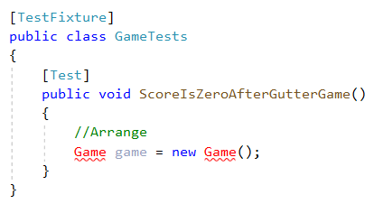
TDD design
Notes:
Steps
Create a test “ScoreIsZeroAfterGutterGame” (when you roll in the gutter 20 times, your score should be zero)

Slide 25
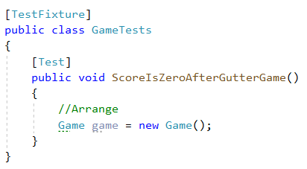

TDD design
Notes:
Steps
Create an (empty) “Game” class so the test code compiles

Slide 26
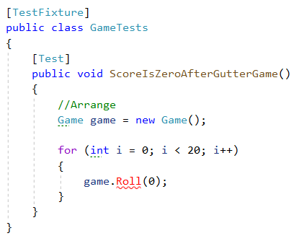

TDD design
Notes:
Steps
Roll 20 times in the gutter in the test. Note that the “Roll” function doe not exist yet.

Slide 27
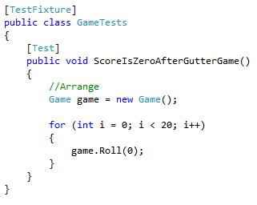
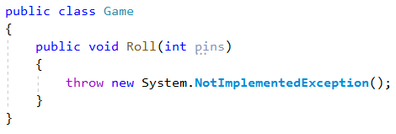
TDD design
Notes:
Steps
Add a stub for the roll method to make the test code compile

Slide 28
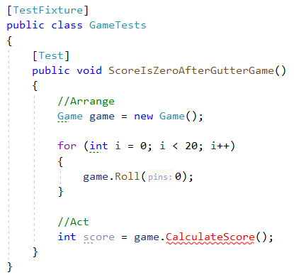
TDD design
Notes:
Steps
A made-up method “CalculateScore” will be the method that is tested (Act) . The “CalculateScore” method does not exist yet in the “Game” class.

Slide 29
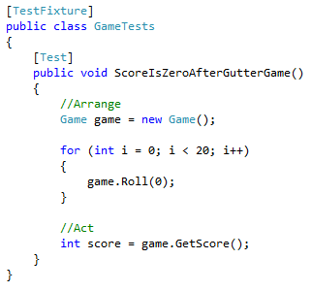
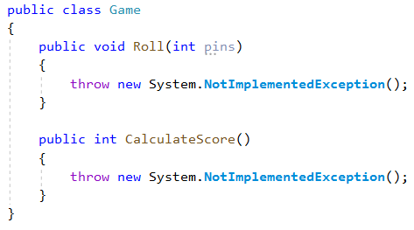
TDD design
Notes:
Steps
Add a stub for the “CalcualteScore” method.

Slide 30
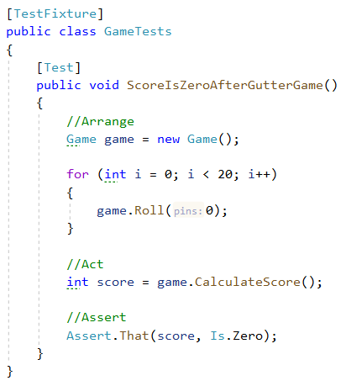
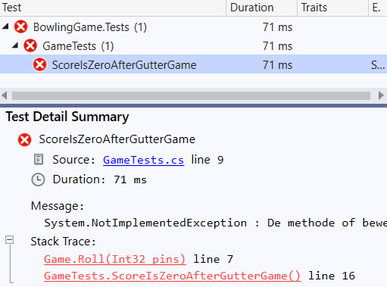
TDD design
Notes:
We now have a first red test.

Slide 31
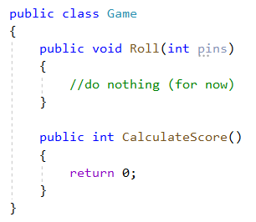
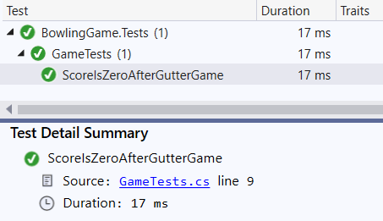
TDD design
Notes:
We write as little code as possible to make the test green.

Slide 32
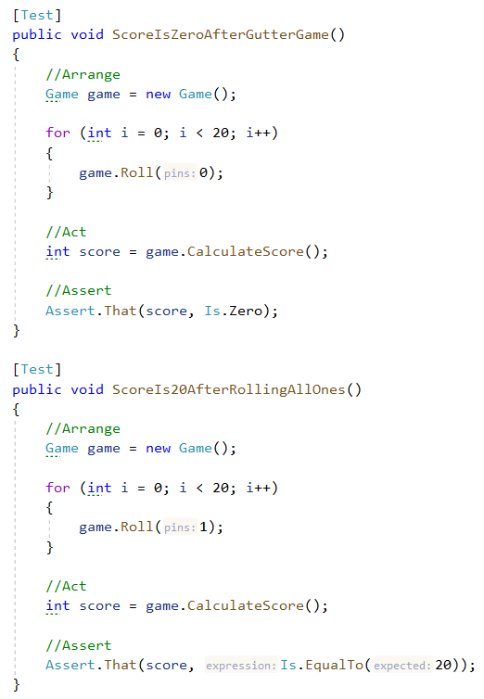
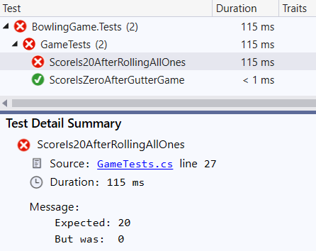
TDD design
Duplicate game instantiation
Duplicate roll for loop
Notes:
Steps
Add a second test “ScoreIs20AfterRollingAllOnes”
We now have a red test again.
We also see some things we should refactor later:
In each test a “Game” is instantiated (duplicate code, not DRY)
In both tests we use a for loop to roll the ball a certain amount of times (duplicate code, not DRY)

Slide 33
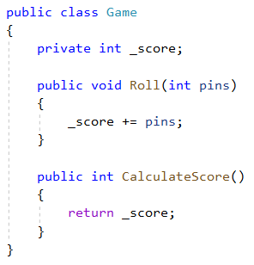
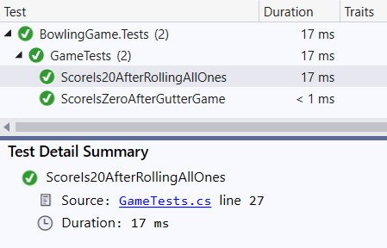
TDD design
Duplicate game instantiation
Duplicate roll for loop
Notes:
Steps
Make the test green by adding the pins in the rolls in a private variable. We return that variable when the score is asked.

Slide 34
TDD design
Duplicate game instantiation
Duplicate roll for loop
Notes:
Steps
Let’s refactor out the duplicate game instantiation

Slide 35
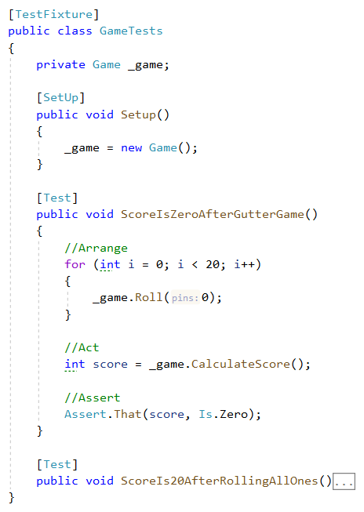
TDD design
Duplicate roll for loop
Notes:
Steps
Add the construction of a game in a setup method which will be executed before each test is run

Slide 36
TDD design
Duplicate roll for loop
Notes:
Steps
Let’s refactor out the duplicate for loop

Slide 37
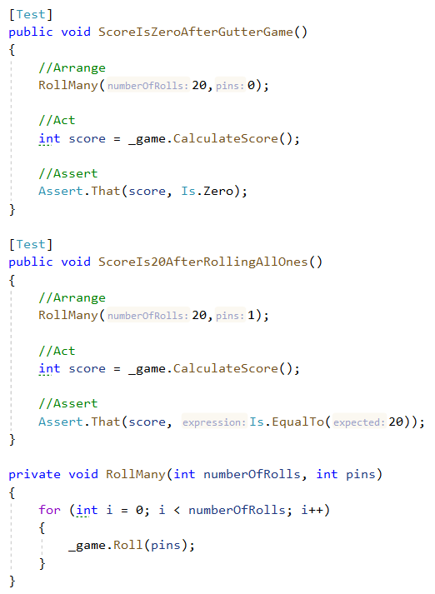
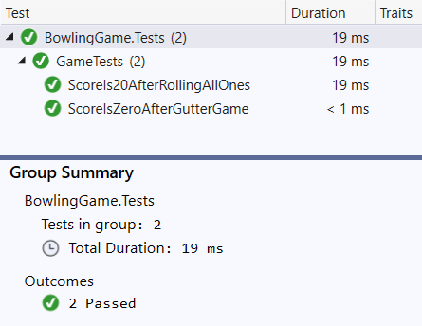
TDD design
Notes:
Steps
Extract a “RollMany” method
Run the tests -> Everything is still green ☺

Slide 38
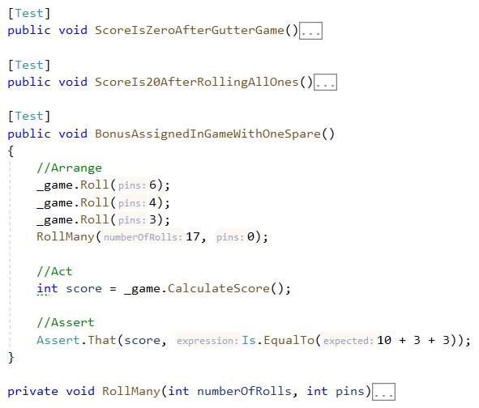
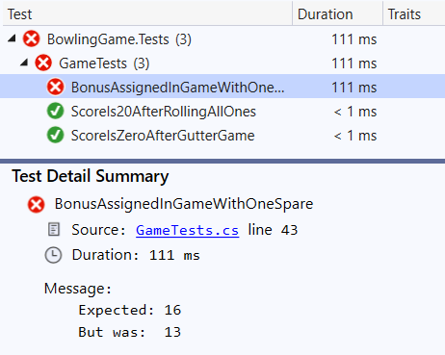
TDD design
Ugly code for rolling spare in test
Notes:
Steps
Add a test “BonusAssignedInGameWithOneSpare”
We note that the code to roll a spare should maybe be refactored
We have a new red test. Let’s try to make it green…

Slide 39
TDD design
Tempted to remember previous rolls.
Roll calculates score, but the name does not imply that
Score does not calculate score but the name implies that it should
Our design is wrong!
Ugly code for rolling spare in test
Notes:
Steps
To calculate a spare score we need to remember the rolls in the game
It seems that the “Roll” method calculates the score while its name does not suggest that
At the same time the “GetScore” method suggests it will calculate the score but it does not do that
-> The design of our code needs to be reworked. So we should
comment out the last tests so that all tests are green again (next slide)
Put on our refactoring hat and redesign the code (after next slide)
We use the existing tests to verify everything is still ok after the refactor operation (after next slide)

Slide 40
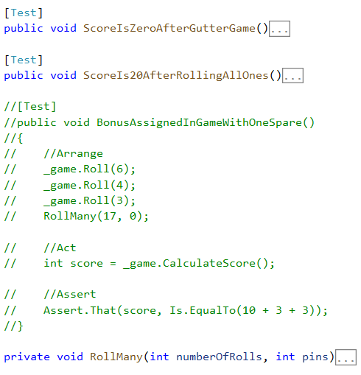
TDD design

Slide 41
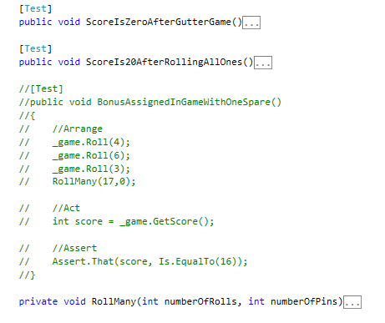
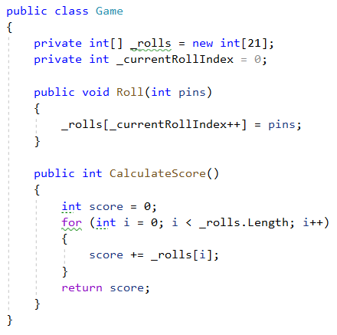
TDD design
Notes:
Steps
Store the rolls in an array (Length = 21 because of the possible 3th roll in the last frame)
Iterate over the rolls in the “CalculateScore” method to calculate a sum

Slide 42
TDD design
Ugly code for rolling spare in test
Notes:
Steps
Comment out the “Spare” test again
-> We now have a red test again.

Slide 43
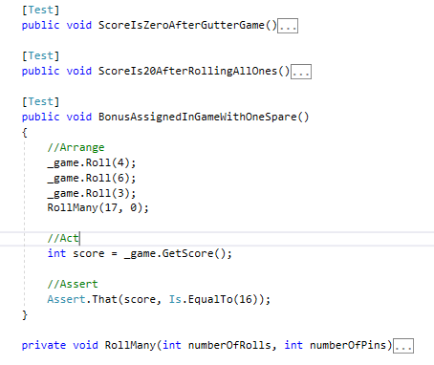
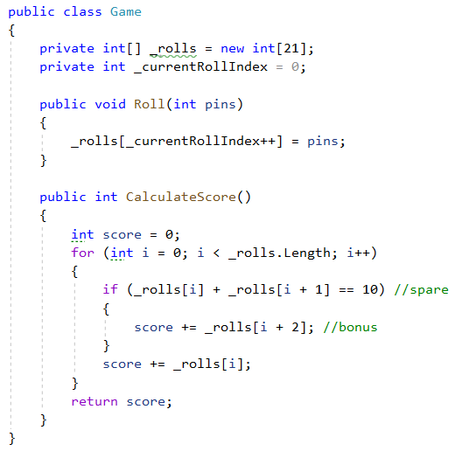
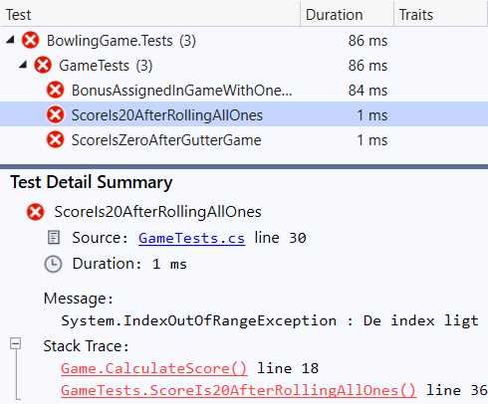
TDD design
All tests fail now because. We go out of range at the end of the _rolls array. Also “i” does not always refer to the first ball of the frame..
We need to walk through the array two balls (frame) at a time
Ugly code for rolling spare in test
Notes:
Steps
Try to make the test green by adding a check in the for loop of “CalculateScore”
But the solution causes all tests to break.
The problem is that “i” might not refer to the first roll of a frame. When it is not, the code tries to find the next roll outside the bounds of the _rolls array.
-> Our design is still wrong. We need to walk over the “_rolls” array frame by frame 2 balls at a time (with a strike you only roll once in a frame but that is a concern for later).
-> So lets try another solution…

Slide 44
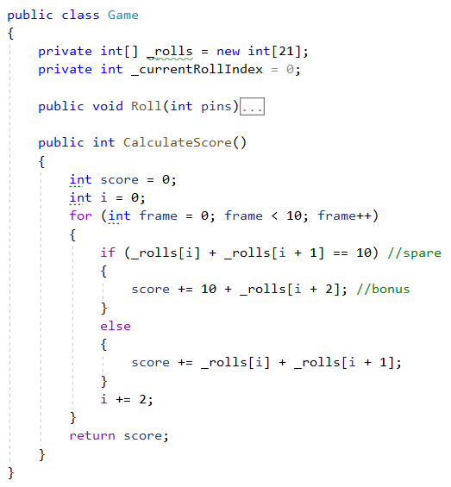
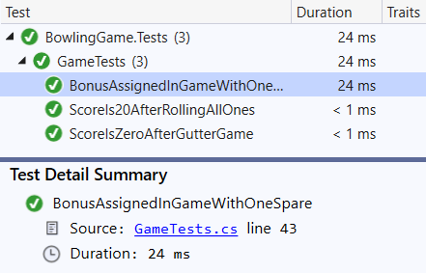
TDD design
Ugly code for rolling spare in test
Notes:
Steps
Change the for loop to run over 10 frames
Remember the current position in the “_rolls” array by adding 2 (rolls) to “i” each time
Add an if-test to check if the current frame is a spare. If so add the first throw of the next frame to the score.
-> All test are green ☺. Let’s put on our refactoring hat.
Note:
We took a shortcut here. Normally we should comment out the new test (spare), refactor the code and then check if the other tests are still green.
Next you uncomment the new test (spare) and add the logic to incorporate the spare bonus.

Slide 45
TDD design
Ugly code for rolling spare in test
Ugly comment in test condition (spare)
Ugly variable name “i”
Notes:
Steps
We note 2 extra smells in our code:
The condition in the if-test (“CalculateScore”) is hard to read
The variable “i” (“CalculateScore”) should have a more meaningful name
Earlier we already noted we should have a better way to roll a spare in a test

Slide 46
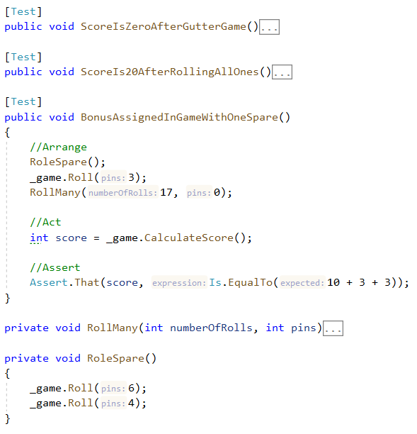
TDD design
Ugly code for rolling spare in test
Ugly comment in test condition (spare)
Ugly variable name “i”
Notes:
Steps
Extract a “RollSpare” method in the test
-> All tests still green ☺

Slide 47
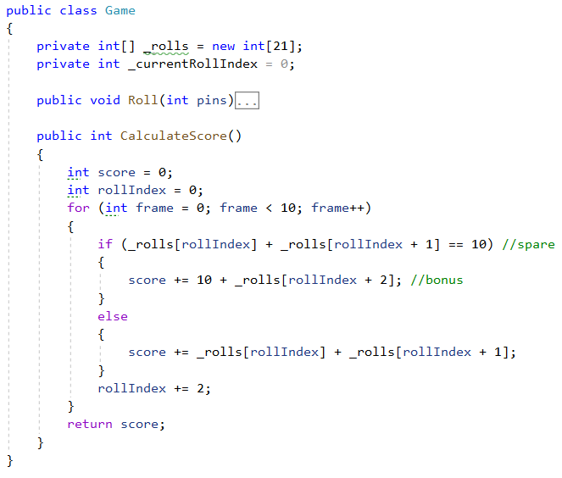
TDD design
Ugly comment in test condition (spare)
Ugly variable name “i”
Notes:
Steps
(“CalculateScore”) Rename “i” to “rollIndex”
-> All tests still green ☺

Slide 48
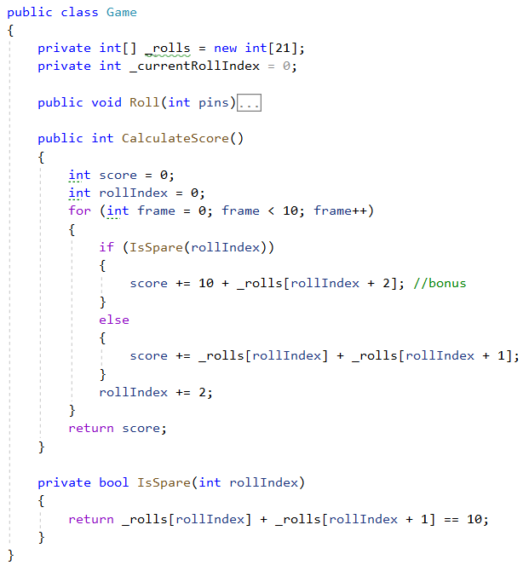
TDD design
Ugly comment in test condition (spare)
Notes:
Steps
(“CalculateScore”) Extract an “IsSpare” method from the if condition
-> All tests still green ☺

Slide 49
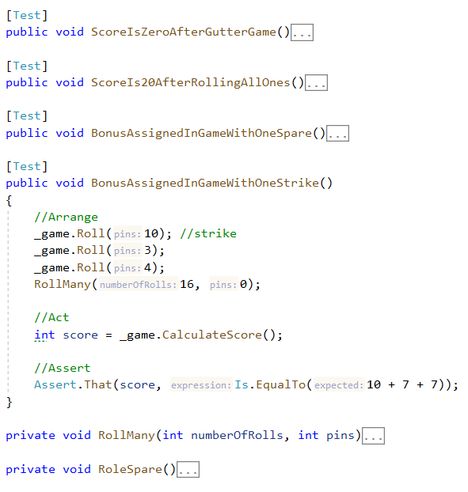
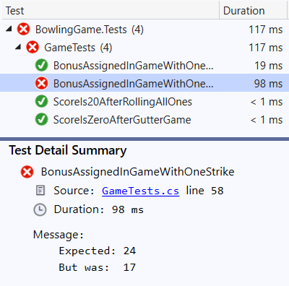
TDD design
Notes:
Steps
Add a test “BonusAssignedInGameWithOneStrike”
-> We have a new red test

Slide 50
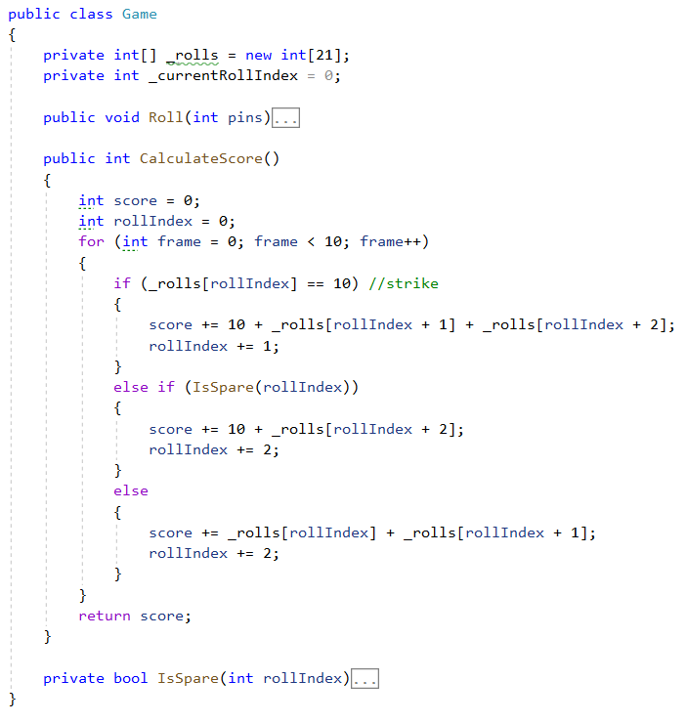
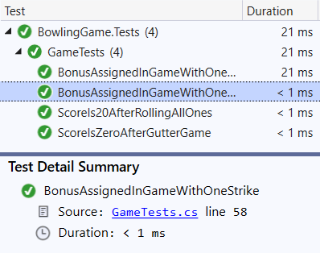
TDD design
Notes:
Steps
(“CalculateScore”) Add an extra if-test to check if the first roll of the current frame is a strike
Assign a strike bonus (10 + next roll + roll after next roll)
Advance the “rollIndex” by one in case of a strike and by two otherwise
-> All tests are green ☺. Put on the refactor hat.

Slide 51
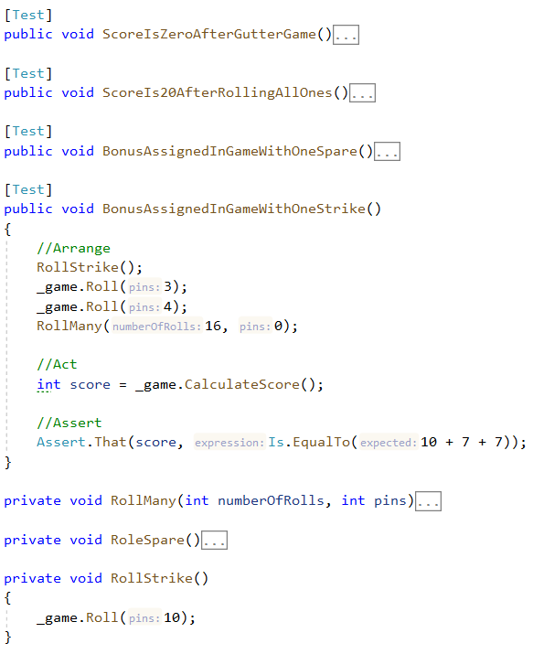
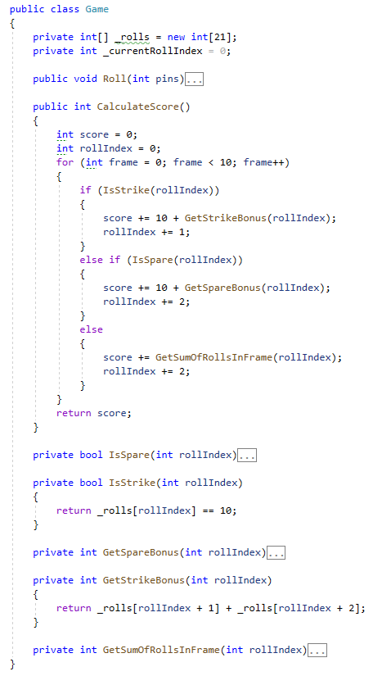
TDD design
Notes:
Steps
Extract an “IsStrike” method to make the if-test more readable
Extract a “SpareBonus” method to make the calculation of a spare score more readable
Extract a “StrikeBonus” method to make the calculation of a strike score more readable
Extract a “SumOfRollsInFrame” method to make the calculation of a normal frame more readable
-> All tests still green ☺

Slide 52
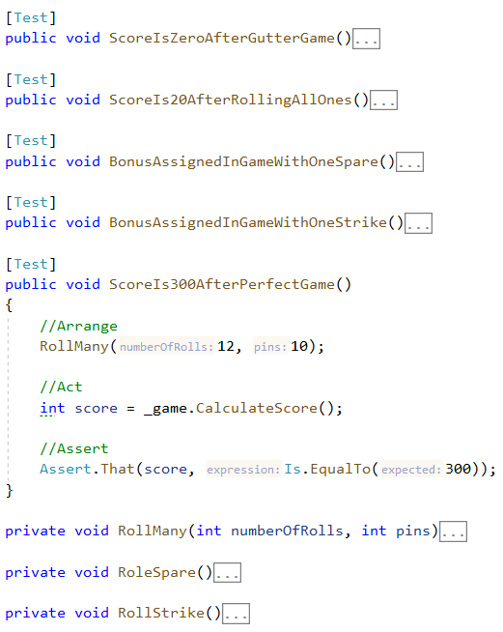
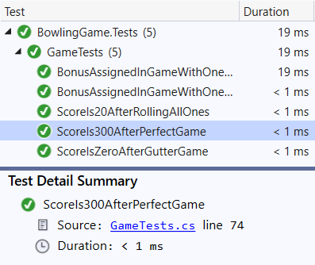
TDD design
Notes:
Steps
Add a “ScoreIs300AfterPerfectGame” Tests
-> All test still green ☺
-> We could also add tests for special cases like 2 spares in a row, but we are going to leave it with this. All cases will be covered by the current production code, but if you have doubts, just write a test for it ☺.
Note the difference with the design we originally had in mind.

Slide 53

Test doubles

Slide 54
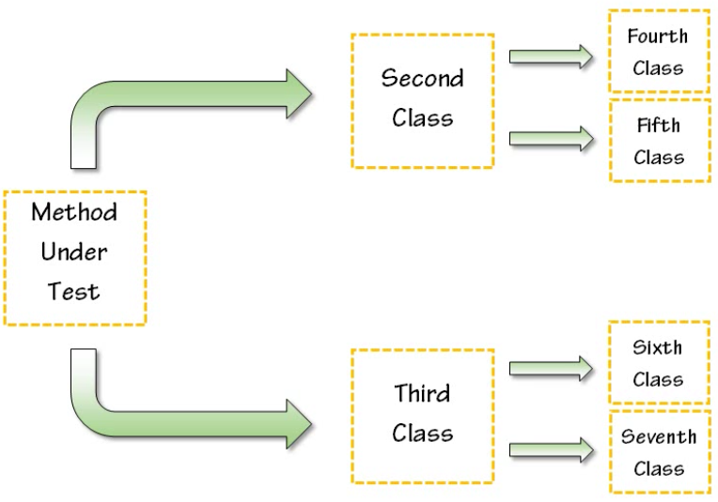
Test doubles
Code can depend on
Other classes
Other systems (e.g. database)
=> Difficult to write unit test
Test doubles
Replace dependencies with fake copies
Encourages good coding principles
Isolate the code you want to test
Notes:
Unit Testing Can Be Difficult
Writing unit tests for anything other than the simplest code can quickly become quite difficult.
Testing methods, for example, that have a fair amount of branching logic can make it difficult to isolate the particular piece of code that you're trying to test.
And you may have also found that it becomes increasingly difficult when the code that you're testing makes all sorts of calls to other classes.
And inevitably, you'll end up writing tests for a piece of code that accesses other systems, such as database servers, email servers or web services.
Not only does that make it difficult to write your tests but it also leaves you worrying whether your tests are going to cause problems in those external systems.
How Test Doubles Can Help
Test doubles can help you to isolate the pieces of code that you want to test and they can help you prevent those external classes and resources from coming into play at all.
Test doubles are used to remove dependencies of code that is not under test and replace them with fake copies of the dependencies.
You have complete control over what these fakes do. These fakes contract interactions between the code you're testing and the dependencies so that you can assert in your tests that everything happened as you expected.
Best of all, the use of test doubles encourages you to use good coding principles that will help you to make your code easier to maintain.

Slide 55
Moq
Moq (pronounced "Mock-you" or just "Mock") is a mocking library for .NET
Supports mocking interfaces as well as classes.
(Relatively) simple and straightforward API
Takes full advantage of .NET Linq expression trees and lambda expressions
(A “Mock” is a kind of “Test double”)
Notes:
Lambda expressions
A lambda expression is an anonymous function. By using lambda expressions, you can write local functions that can be passed as arguments or returned as the value of function calls.
To create a lambda expression, you specify input parameters (if any) on the left side of the lambda operator =>, and you put the expression or statement block on the other side.
For example, the lambda expression x => x * x specifies a parameter that’s named x and returns the value of x squared.

Slide 56
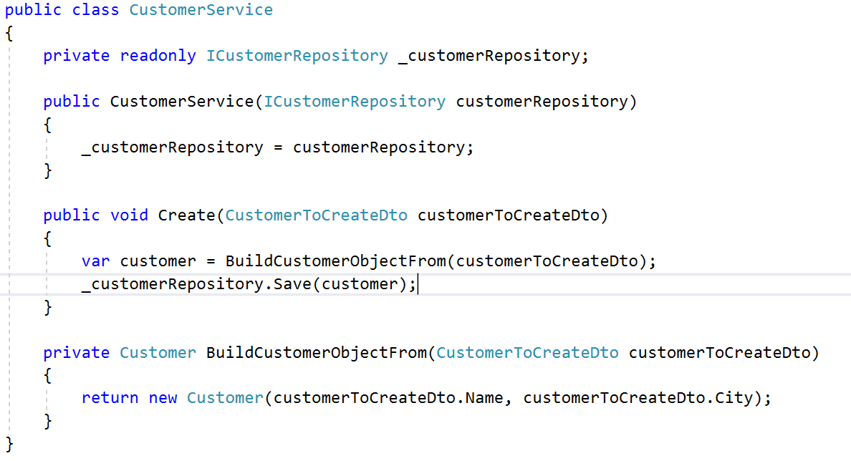
Moq

Slide 57
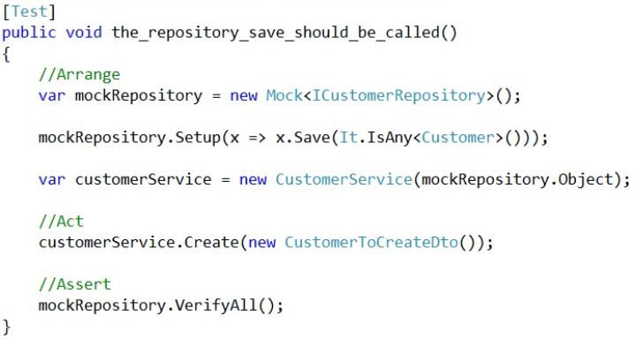
Moq - AAA
Notes:
The AAA Syntax
The Arrange, Act, Assert pattern is commonly found in most mocking framework these days.
This is a pattern that you're going to follow when you're creating the tests that you use mock objects.
The first part of it or the arrange is where you create your mock objects and create your system under test, pass the mock objects into the system under test and do any other initialization that you may need to do to allow the test to execute properly.
After all that initialization is finished, you then go ahead and do the act. In the act all you're doing is executing the system under test. Usually, this is going to be one line of code where you put system under test dot and then the method that needs to be executed for the test to occur.
Finally, you're going to assert that the system under test has worked in the way that you wanted to. In mocking, this is going to be looking at the mock objects and verifying that they were interacted with by the system under test as you expect.

Slide 58
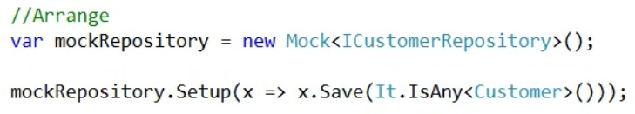
Moq - Setup
“Setup” method sets expectations
Uses lambda expressions
Example: expect the method “Save” to be called with some customer parameter

Slide 59

Moq - Verify
The Assert in AAA
Did a method get called?
How many times?
Notes:
mockCustomerRepository.Verify(); => Were all expected methods defined in setup (and marked as “verifiable”) called?
mockCustomerRepository.Verify(x => x.Save(It.IsAny<Customer>()), Times.Exactly(3)); => Is the method “Save” called exactly 3 times (with some customer paramter)?
mockCustomerRepository.VerifyAll(); => Were all expected methods defined in setup called (even if they are not marked as verifiable)?

Slide 60

Moq – Return Values
Functions in a mock may return values
These return values may influence execution flow
Set up mock to return certain values
Notes:
Return Values
When we're writing mock test, one of the things that we need to be concerned about is what are the return values of the mock or fake objects that we're working with inside of the system under test?
When we're calling off to a dependency (mock) inside the system under test it's really common for that dependency to return a value back.
Sometimes the system under test then makes a decision to execute one of a number of different code execution pass based on what value was returned back.
So these return values that we're seeing from our mock objects are very important for the execution flow so that you can run the test in the way that you expected to.
What we can do is set up our mock object so that they return different values under different circumstances and allow for the code execution path the vary based on them.
By default inside of mock, if we don't define what it's going to return it will return the default value for the type that is coming out.
When a mock returns complex types it returns back a null value. The “Returns” method allows you to change the default behavior.

Slide 61
Moq – further reading
Pluralsight:
https://app.pluralsight.com/library/courses/moq-dot-net-core-unit-tests
Quickstart:
https://github.com/Moq/moq4/wiki/Quickstart
API documentation:
http://www.nudoq.org/#!/Projects/Moq

